Slide 1

UI Session 0
Foundation session
UI/UX Design Session

Slide 2
UI/UX Design Mytes
UI/UX Design is a One-Time Task:
UI/UX Design is Only Wireframing:
It's an ongoing process of improvement.
It involves research, usability testing, and more.
UI/UX Design Session

Slide 3
UI/UX Design Challenges
User Research Complexity: Time-consuming and resource-intensive.
Accessibility: Designing for all, including those with disabilities.
Stakeholder Management: Justifying design choices.
Complex User Flows: Navigating intricate user journeys.
Screen Readers: NVDA
Color Contrast Checkers: WebAIM's Color Contrast Checker
Accessibility Testing Tools: Axe, Achecker
Accessibility Guidelines: WCAG
Design Software with Flow Features: Adobe XD, Figma, Sketch
Mind Mapping Apps: MindNode.
Specialized User Flow Software: Overflow.io.
Emails, Trello, Slack, Google Drive, Proofhub
Google Forms, UserTesting.com, Google Analytics (checking how users navigate the existing website), TryMyUI
UI/UX Design Session

Slide 4
People Challenges when working with clients
Resistance to Change:
Limited Budget:
Inconsistent Feedback:
Lack of User Data:
Design by Committee:
Sudden Changes:
Limited Design Authority:
Resistance to Accessibility:
Pushback on design recommendations from clients.
Constraints on research and design time.
Unclear or varying client input.
Insufficient user insights.
Multiple stakeholders' opinions.
Neglecting inclusive design in favor of budget/time.
Abrupt project shifts.
Reduced creative input.
UI/UX Design Session

Slide 5
Key Takeways - Articulating Design Decisions
Begin with a "yes" to show understanding and unity, even if you disagree.
Gracefully address CEO's concerns in presentations.
Build hypotheses when facing opposing opinions.
Focus on a functional perspective over subjective one.
Effective design articulation:
a. Appeal to shared goals.
c. Maintain a design decision log.
d. Practice presentations for confidence.
e. Bring a supporter to meetings for backup if possible.
b. Adopt a facilitator mindset.
UI/UX Design Session

Slide 6
Key Takeways - UX Team of One
Design Brief
Task Flows
Heuristic Markup
5 Second Tests
Comparative Assessment
Define the collective design goal by engaging with design teams
establishing the who, what, and why regarding main features, focus, and target audience.
Collaborate with designers to create low-fidelity sketches of the user flow on paper,
allowing early identification of potential development roadblocks and edge cases.
Evaluate the quality of your product's user flow from start to finish,
like a report card, identifying areas for improvement or removal within the flow.
- Assess user impressions by showing a screen for 5 seconds to gauge what the user remembers.
Analyze UX patterns from popular websites and apps like Amazon and Facebook to align with your users' expectations
to improve your own product's user experience.
UI/UX Design Session

Slide 7
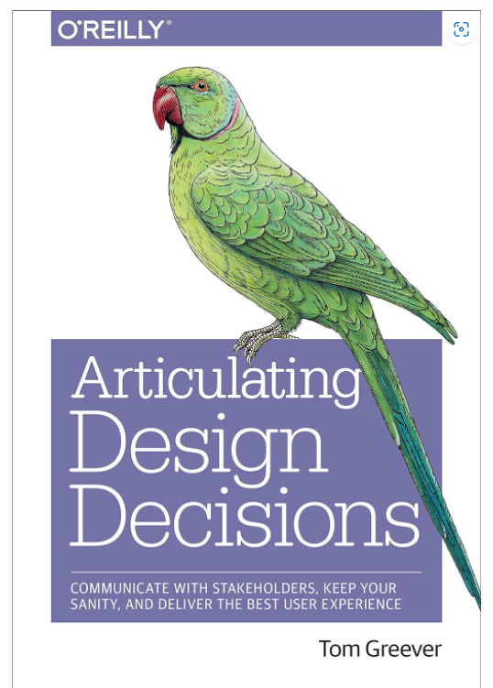
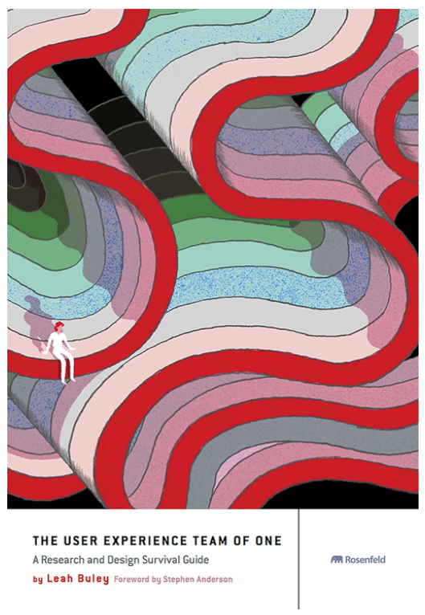
Design Book recommandations
UI/UX Design Session

